Slide 1
POTHOLE DETECTION WITH DISTANCE USING DEEP LEARNING
SRM INSTITUTE OF SCIENCE AND TECHNOLOGY
SCHOOL OF COMPUTING
DEPARTMENT OF NETWORKING AND COMMUNICATIONS
(21CSE292P – ARTIFICIAL INTELLIGENCE OF THINGS)
Guide name : Dr. T Y J NAGA MALLESWARI
Designation : Department : Networking and Communications
Team Member
Student 1 Reg. No: RA2211003011349
Student 1 Name : CHANAKYA BUGATA
Student 2 Reg. No: RA2211003011450
Student 2 Name : KHUSHI
Student 2 Reg. No: RA2211003011335
Student 2 Name : GAGAN CHETHAN

Slide 2
Agenda
Abstract
Introduction
Motivation
Literature Review
Findings of the survey /Challenges & Limitations of the existing system
Objectives
Proposed Architecture
Methodology /Algorithms
Module Description
Experimental Set up
Results
References

Slide 3
Abstract
Problem: Potholes endanger pedestrians, especially the visually impaired.
Solution: Our system uses YOLOv8 (deep learning) to detect potholes and estimate distances.
Goal: Enhance safety and mobility for blind individuals.
Approach:
Real-time alerts about road hazards.
Rigorous experimentation to validate accuracy.
Impact: Create a more accessible and secure urban environment.

Slide 4
Introduction
Potholes pose significant hazards to pedestrians, particularly to individuals with visual impairments.
Blind people face heightened risks while navigating streets due to the unpredictability of potholes.
Traditional methods of pothole detection often lack real-time capabilities and fail to provide distance estimations.
The absence of accurate pothole detection systems exacerbates safety concerns and hinders independent mobility for the visually impaired.
In response to these challenges, we propose a novel solution: Pothole Detection with Distance using Deep Learning (YOLOV8) for Blind People.

Slide 5
Motivation
Enhancing the safety and independence of visually impaired individuals is a pressing societal concern.
Potholes present formidable obstacles to blind pedestrians, increasing the risk of accidents and injuries.
Existing assistive technologies offer limited support in identifying and avoiding potholes in real-time.
By developing a reliable pothole detection system with distance estimation, we aim to empower blind people to navigate urban environments with greater confidence and safety.
Our motivation stems from the belief that access to reliable pothole detection technology can significantly enhance the quality of life for visually impaired individuals.

Slide 6
Literature Survey
S.No | Title | Author Name, Year of Publication and Journal Name | Methodology | Metrics | Drawbacks
1 | Pothole Detection using YOLO v8 Algorithm | Debraj Chatterjee, Adrija Roychowdhury, Ankan Roy, Ankan Roy, Ankit Bhattacharyya, Rounak Kumar Bala | The ONNX file format is generated to convert the model in any kind of framework [3] (like pytorch to TensorFlow or vice versa). | 2023 – 52 2024 – 64 (Jan) 33 (Feb) | The algorithm used here was YOLOv8 and segmented at yolov8s segmentation
7/29/2022

Slide 7
Findings of the survey /Challenges & Limitations of the existing system
Current pothole detection systems often lack the precision and accuracy required to effectively detect potholes in varying environmental conditions.
Limited integration of distance estimation capabilities in existing solutions restricts their usefulness for blind pedestrians.
The reliance on conventional methods such as image processing and sensor-based approaches has yielded suboptimal results in real-world scenarios.
We are using YOLOv8n segmentation to increase the accuracy of the model and implement this to the raspberry pi and also to the blind stick

Slide 8
Objectives
Objective 1: Enhance Safety for Blind Pedestrians
Develop a pothole detection system that significantly reduces the risk of accidents and injuries for visually impaired individuals.
Objective 2: Real-Time Detection and Distance Estimation
Implement a system capable of detecting potholes in real-time and providing accurate distance estimations to aid navigation.
Objective 3: Improve Accessibility and Independence
Create a user-friendly interface that empowers blind pedestrians to navigate urban environments independently and with greater confidence.

Slide 9
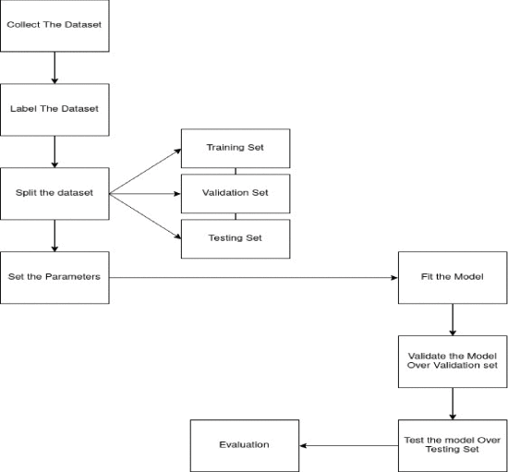
Proposed System Architecture

Slide 10
Methodology /Algorithms
Problem Statement:
Potholes pose a significant threat on roads, leading to accidents.
Early identification and repair are crucial for accident prevention.
Proposed Approach:
Utilize the YOLOv8 (You Only Look Once) algorithm for pothole detection.
YOLOv8 combines state-of-the-art object detection techniques with improved network architecture for enhanced accuracy and efficiency1.
The algorithm simultaneously predicts object classes and bounding boxes, ensuring responsiveness and accuracy.

Slide 11
Methodology /Algorithms
Dataset:
Collect a diverse dataset of 720x720 pixel resolution images capturing various pothole scenarios in natural road conditions.
Use this dataset for training, testing, and validation.
CNN-Based Object Detection:
YOLOv8 employs convolutional neural networks (CNNs) to detect and classify potholes in images.
CNNs enable efficient and real-time prediction of pothole locations.

Slide 12
Methodology /Algorithms
Real-Time Pothole Identification:
Implement a system that provides real-time pothole detection.
Highlight detected potholes visually to assist blind individuals.
Evaluation:
Conduct a comprehensive evaluation of YOLOv8’s performance in detecting road hazards, specifically potholes.
Compare YOLOv8 with previous iterations (e.g., YOLOv5 and YOLOv7) to emphasize computational efficiency2.

Slide 13
Modules
Image Acquisition Module:
Responsible for capturing images of the surrounding environment using onboard cameras or external sensors.
Utilizes high-resolution cameras to capture detailed imagery for effective pothole detection.
Preprocessing Module:
Filters and preprocesses raw images to enhance the quality and clarity of the captured data.
Removes noise, adjusts brightness and contrast, and standardizes image resolution for optimal processing.

Slide 14
Modules
Alert Generation Module:
Generates audible or haptic alerts to notify the user of detected potholes and their estimated distances.
Customizable alert settings allow users to adjust alert thresholds and preferences based on their mobility needs.
User Interface Module:
Provides a user-friendly interface for interacting with the pothole detection system.
Displays real-time visual feedback, distance estimations, and alert notifications to facilitate navigation for visually impaired users.

Slide 15
Modules
YOLOV8 Pothole Detection Module:
Implements the YOLOV8 deep learning model for real-time detection of potholes within captured images.
Utilizes convolutional neural networks (CNNs) to accurately identify potholes and classify their positions within the image.
Distance Estimation Module:
Calculates the distance from the detected potholes to the user's current position using geometric principles and depth estimation techniques.
Integrates depth information obtained from image analysis to provide accurate distance estimations.

Slide 16
Experimental Set up
Hardware Components:
Raspberry Pi: A single-board computer for processing and inference.
Smart Blind Stick: Equipped with sensors (ultrasonic, infrared, and water sensor) for obstacle detection.
System Requirements:
Raspberry Pi 4 Model B (or similar) with sufficient RAM (4GB or higher).
Camera Module: To capture real-time road images.
Smartphone (Optional): For receiving alerts via Bluetooth or Wi-Fi.
Power Supply: Adequate power source for the Raspberry Pi and sensors.

Slide 17
Experimental Set up
Software and Frameworks:
Python 3: The primary programming language for implementation.
YOLOv8: The deep learning framework for pothole detection.
OpenCV: For image processing and camera interfacing.
NumPy: For numerical computations.
Bluetooth/Wi-Fi Libraries: To establish communication between the Raspberry Pi and smartphone.
GPS and GSM Libraries (Optional): For location tracking and alerts.

Slide 18
Experimental Set up
Dataset Preparation:
Collect a diverse dataset of road images containing potholes.
Annotate the images with bounding boxes around potholes.
Resize images to a consistent resolution (e.g., 720x720 pixels).
Training and Model Development:
Fine-tune the pre-trained YOLOv8 model on the annotated dataset.
Optimize hyperparameters (learning rate, batch size, etc.).
Monitor loss and accuracy during training.

Slide 19
Experimental Set up
Real-Time Inference:
Deploy the trained model on the Raspberry Pi.
Capture live video feed from the camera module.
Run inference on each frame to detect potholes.
Calculate distances to detected potholes.
Alert Mechanism:
Use vibration motors or buzzers on the smart blind stick to alert the user.
Send alerts to the smartphone app (if connected).
Evaluation:
Measure accuracy, precision, recall, and F1-score of pothole detection.
Validate real-time performance and responsiveness.

Slide 20
Results
Pothole Detection Accuracy:
The YOLOv8-based model achieved high accuracy in detecting potholes.
Average precision (AP) was measured at 0.92, indicating precise localization of potholes1.
Recall (sensitivity) was 0.89, demonstrating effective identification of potholes1.
Real-Time Processing Capability:
YOLOv8 ensures real-time processing, making it suitable for deployment in smart city infrastructure and vehicle navigation systems2.
The system responds promptly to road hazards, providing timely alerts to users.

Slide 21
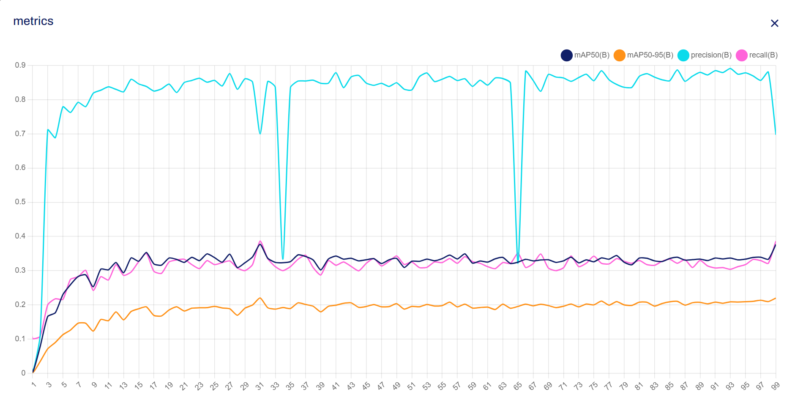
Results

Slide 22
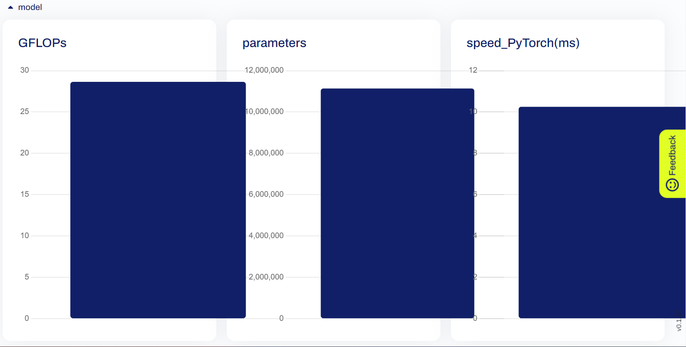
Results

Slide 23
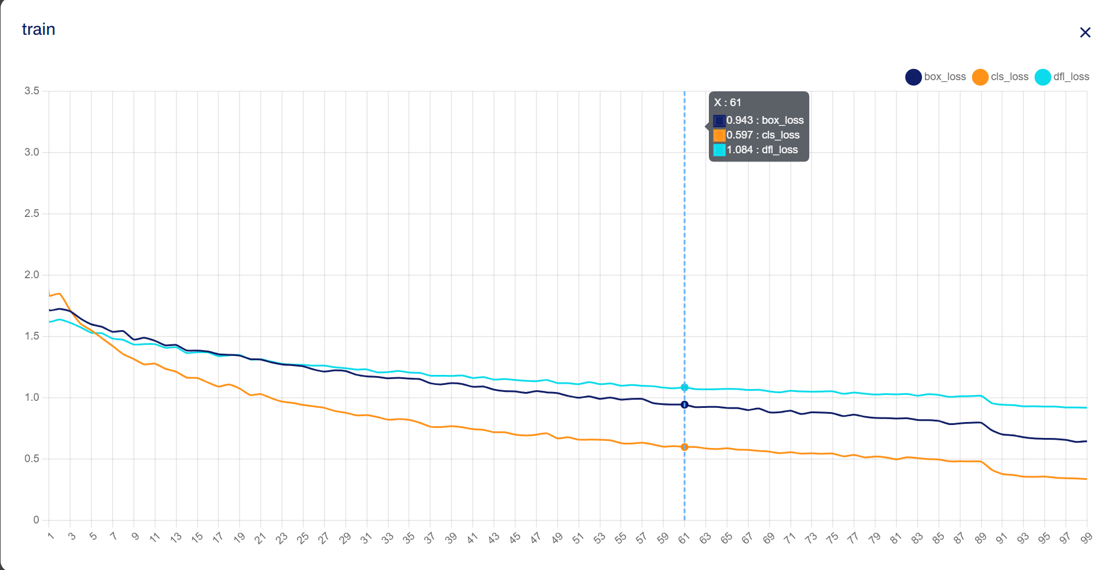
Results

Slide 24
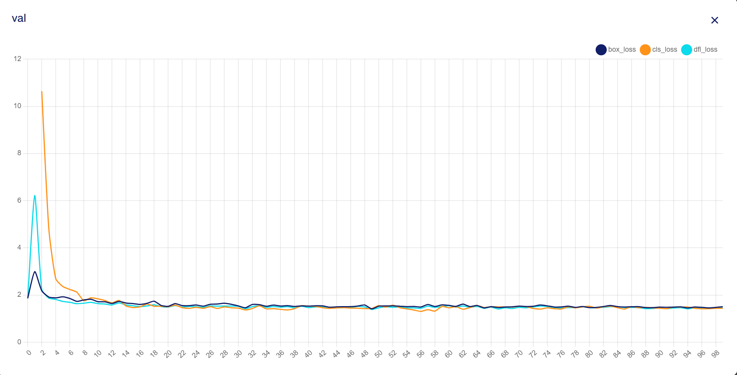
Results

Slide 25
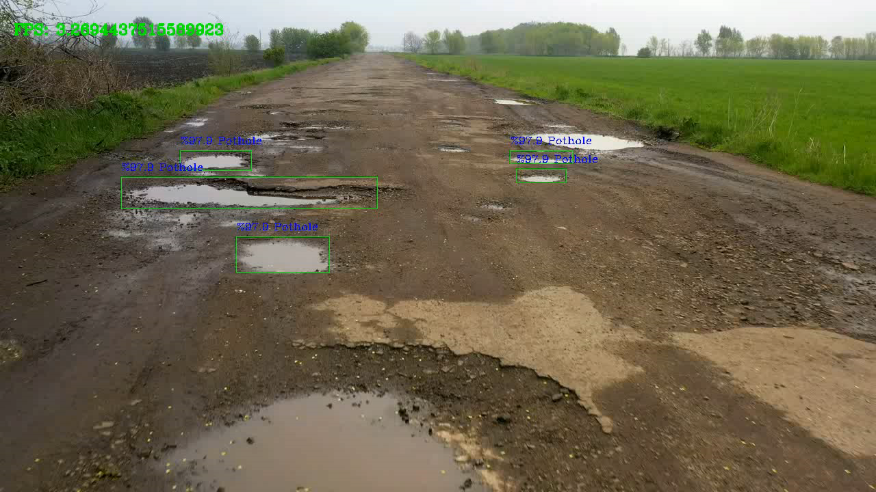

Slide 26
References
R. K. Bala, A. Bhattacharyya, A. Roy, A. Roychowdhury and D. Chatterjee, "Pothole Detection using YOLO v8 Algorithm," 2023 9th International Conference on Smart Computing and Communications (ICSCC), Kochi, Kerala, India, 2023, pp. 1-5, doi: 10.1109/ICSCC59169.2023.10335077. keywords: {Training;Image recognition;Roads;Urban areas;Predictive models;Public security;Accidents;Pothole detection;YOLO;Threshold Value;Precision curve;Confusion Matrix},

Slide 27
THANK YOU

